Slide 1
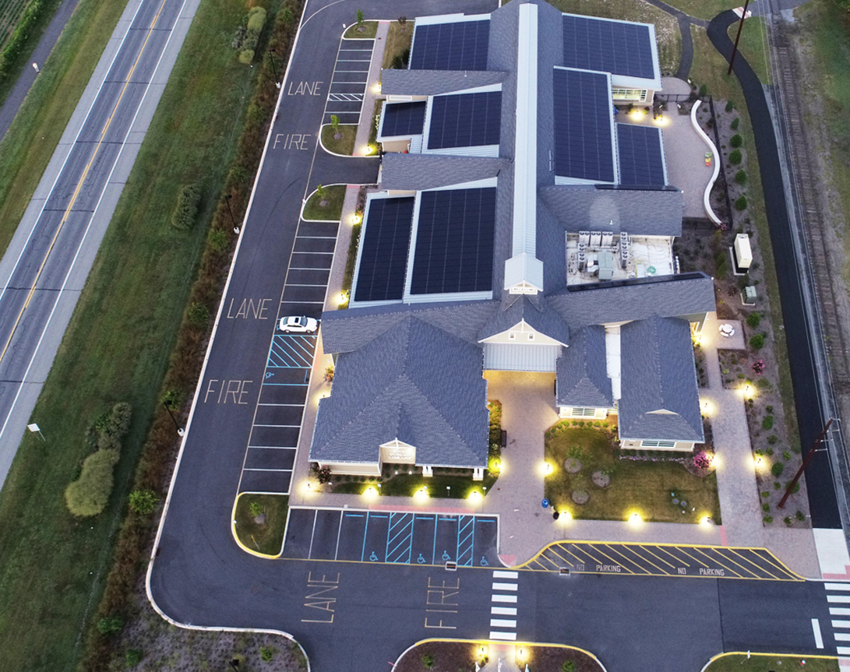
Solar Grants for Public Libraries
1.26.2023
https://www.energizedelaware.org/solarlibraries/

Slide 2
Mission of the DESEU
About DESEU – Energize Delaware
The Delaware Sustainable Energy Utility (DESEU) was created by the Legislature in 2007 to deliver energy efficiency and renewable energy services to Delaware households and businesses.
Inspiring sustainable energy solutions for a thriving environment and economy.

Slide 3
Solar Grants for Delaware Public Libraries
$3 Million for Grants in FY 22/23
Feasibility study required by installer or independent consultant
Can be roof, ground or carport systems
Installation and Utility Upgrades included
Batteries included (optional)

Slide 4
Application Overview
Applications will be accepted after January 26th, 2023
There is no application deadline
Applications will be accepted until all funds have been allocated.

Slide 5
Application Guidelines
Libraries will be required to report production on an annual basis for the first three years in service
Grants will be active for a period of 24 months
Third party system ownership with Power Purchase Agreements are not eligible for funding through this grant
Libraries will maintain ownership of SRECs generated by a project.

Slide 6
Selection Criteria
Reasonable cost per watt
How much energy is being offset by the system
Quality and depth of feasibility study
Age of Roof
Age of Building
Ground Mount vs Roof Mount reasoning
Energy Efficiency of building weatherization/insulation
Use of batteries (emergency backup and/or resiliency)

Slide 7
Selection Criteria
Newer Libraries and Libraries under construction may be more favorable
Library collaboration is encouraged
Project readiness

Slide 8
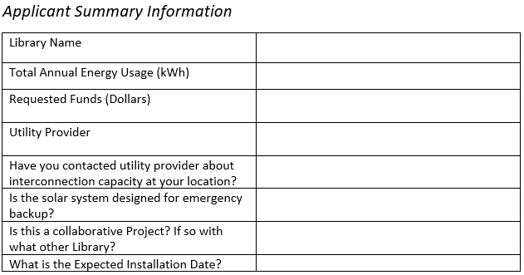
Beginning of the Application

Slide 9
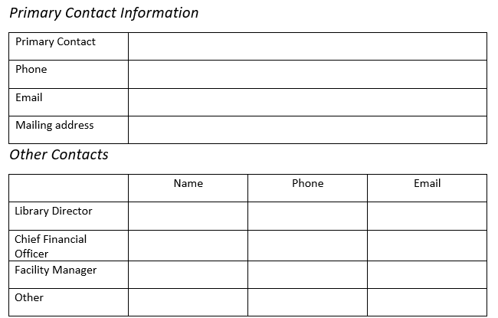
The Application

Slide 10
Feasibility Grant Requirements
A Feasibility Study or Renewable Energy Assessment is Required
Things to Consider:
Does the location get enough sunlight?
Analysis of the existing Electrical usage
Was an engineering study done?
Why were the components selected for this project?
What is the yearly expected output of energy?
Does the substation feeding the Library allow for interconnection?
Will and transformer upgrade be needed?

Slide 11
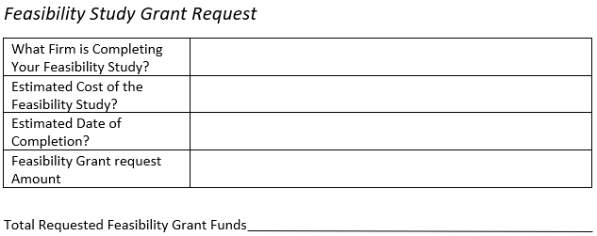
Feasibility Grant Requests

Slide 12
Solar Grant Request

Slide 13
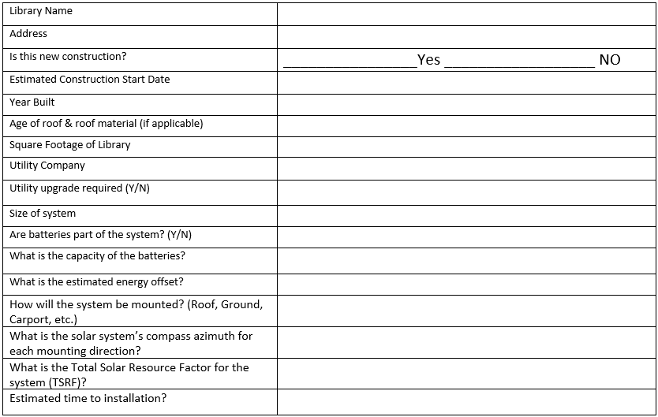
Solar System Location

Slide 14
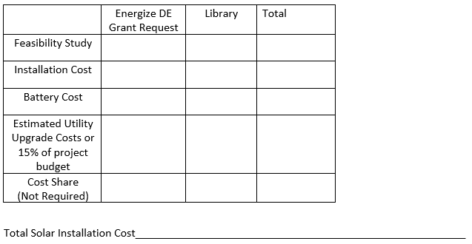
Solar System Cost Breakdown

Slide 15
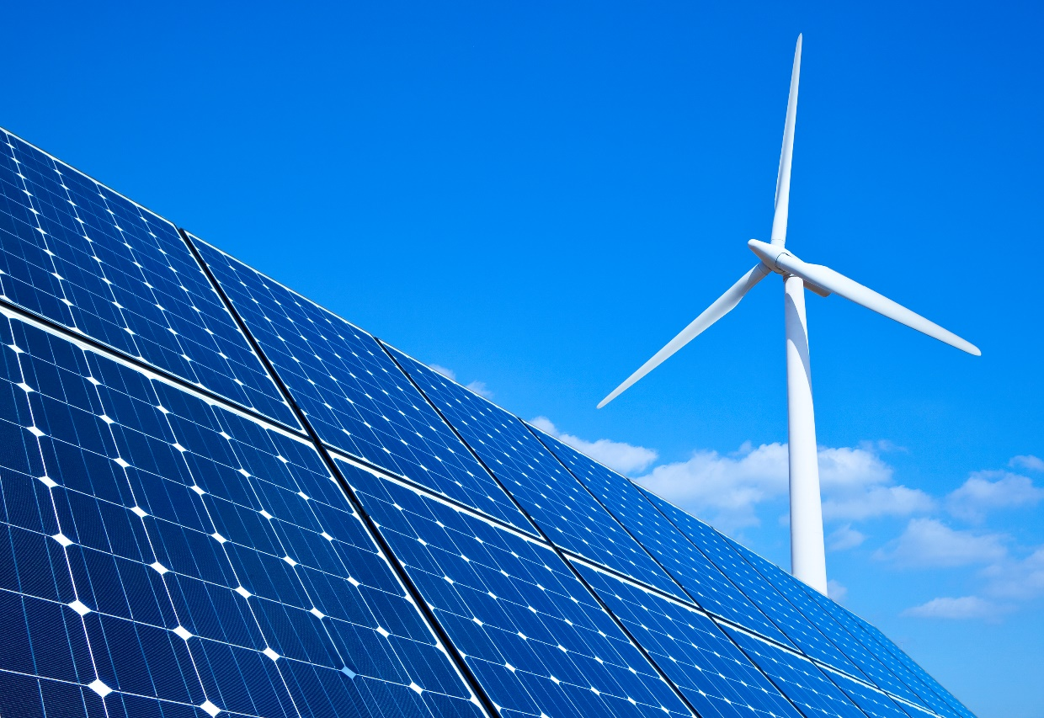
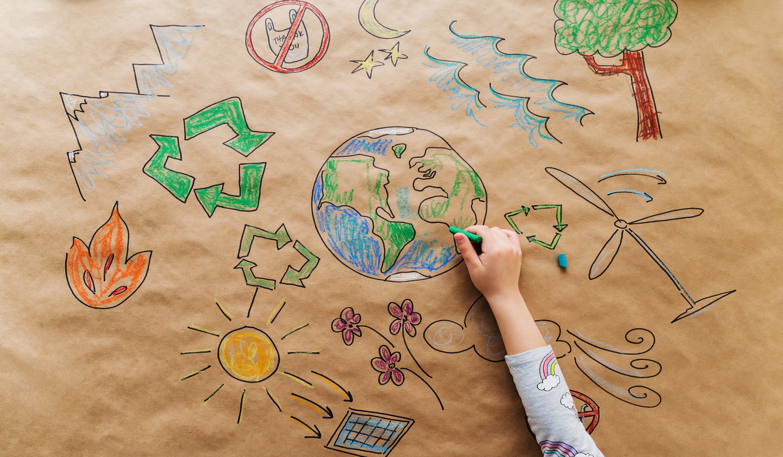
History of Sustainability
We will look favorably upon those applicants that already have established sustainability plans and have a history of clean energy and renewable practices.
We do acknowledge that everyone must start somewhere.

Slide 16
Utility & Installation Costs
Grant requests can include:
Required utility upgrades
Meter upgrades
Electric panel upgrades
Installation costs
Safety barriers, fencing
Signage
If Utility upgrade costs are not known, please reserve 15% of the project cost as a contingency fund

Slide 17
Grant Disbursements
Grant Disbursement for Solar Array Installation Grants:
Energize Delaware will transfer 50% of the invoiced or contract amount when the Library provides documentation that a solar array component purchase order has been approved. And 50% receiving upon installation scheduling date.

Slide 18
Contact Information
Keith Modzelewski
keith@deseu.org
302-883-3048 x 111
Suzanne E. Sebastian
Suzanne.Sebastian@deseu.org
302-883-3048 x 103
www.energizedelaware.org
https://www.energizedelaware.org/solarlibraries/
500 W. Loockerman Street, Suite 400 Dover, DE 19904
​

