Slide 1
Keith Modzelewski
How Solar Works
1.26.2023

Slide 2
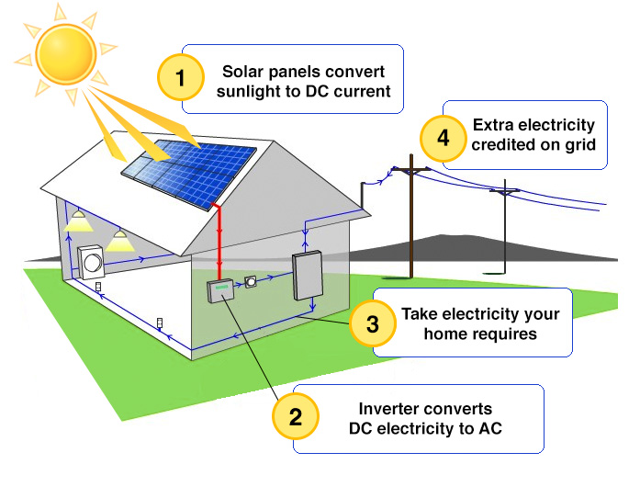
How Solar Works

Slide 3
Solar Components
Solar Panels
Inverter
Net Meter
Monitoring Service
Solar Renewable Energy Credit (SREC)

Slide 4
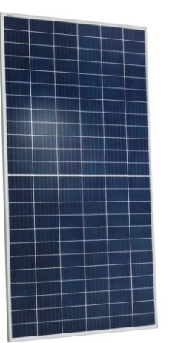
Solar Panels
What is the Panel Wattage?
What is the Warranty?
Typically, 25 years
Maximum degradation ≈. 5% per year
Damage resistance against 1” diameter hail at 50 mph

Slide 5
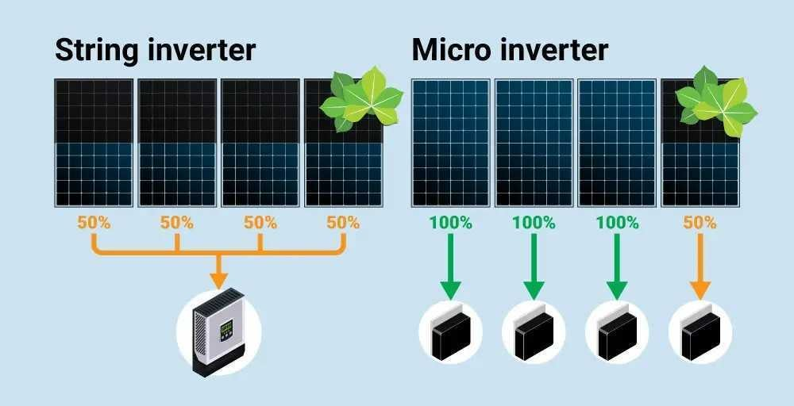
Inverters: String Inverters vs Microinverters
https://www.solarreviews.com/blog/pros-and-cons-of-string-inverter-vs-microinverter

Slide 6
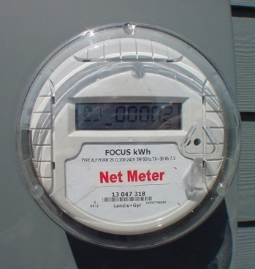
Net Metering

Slide 7
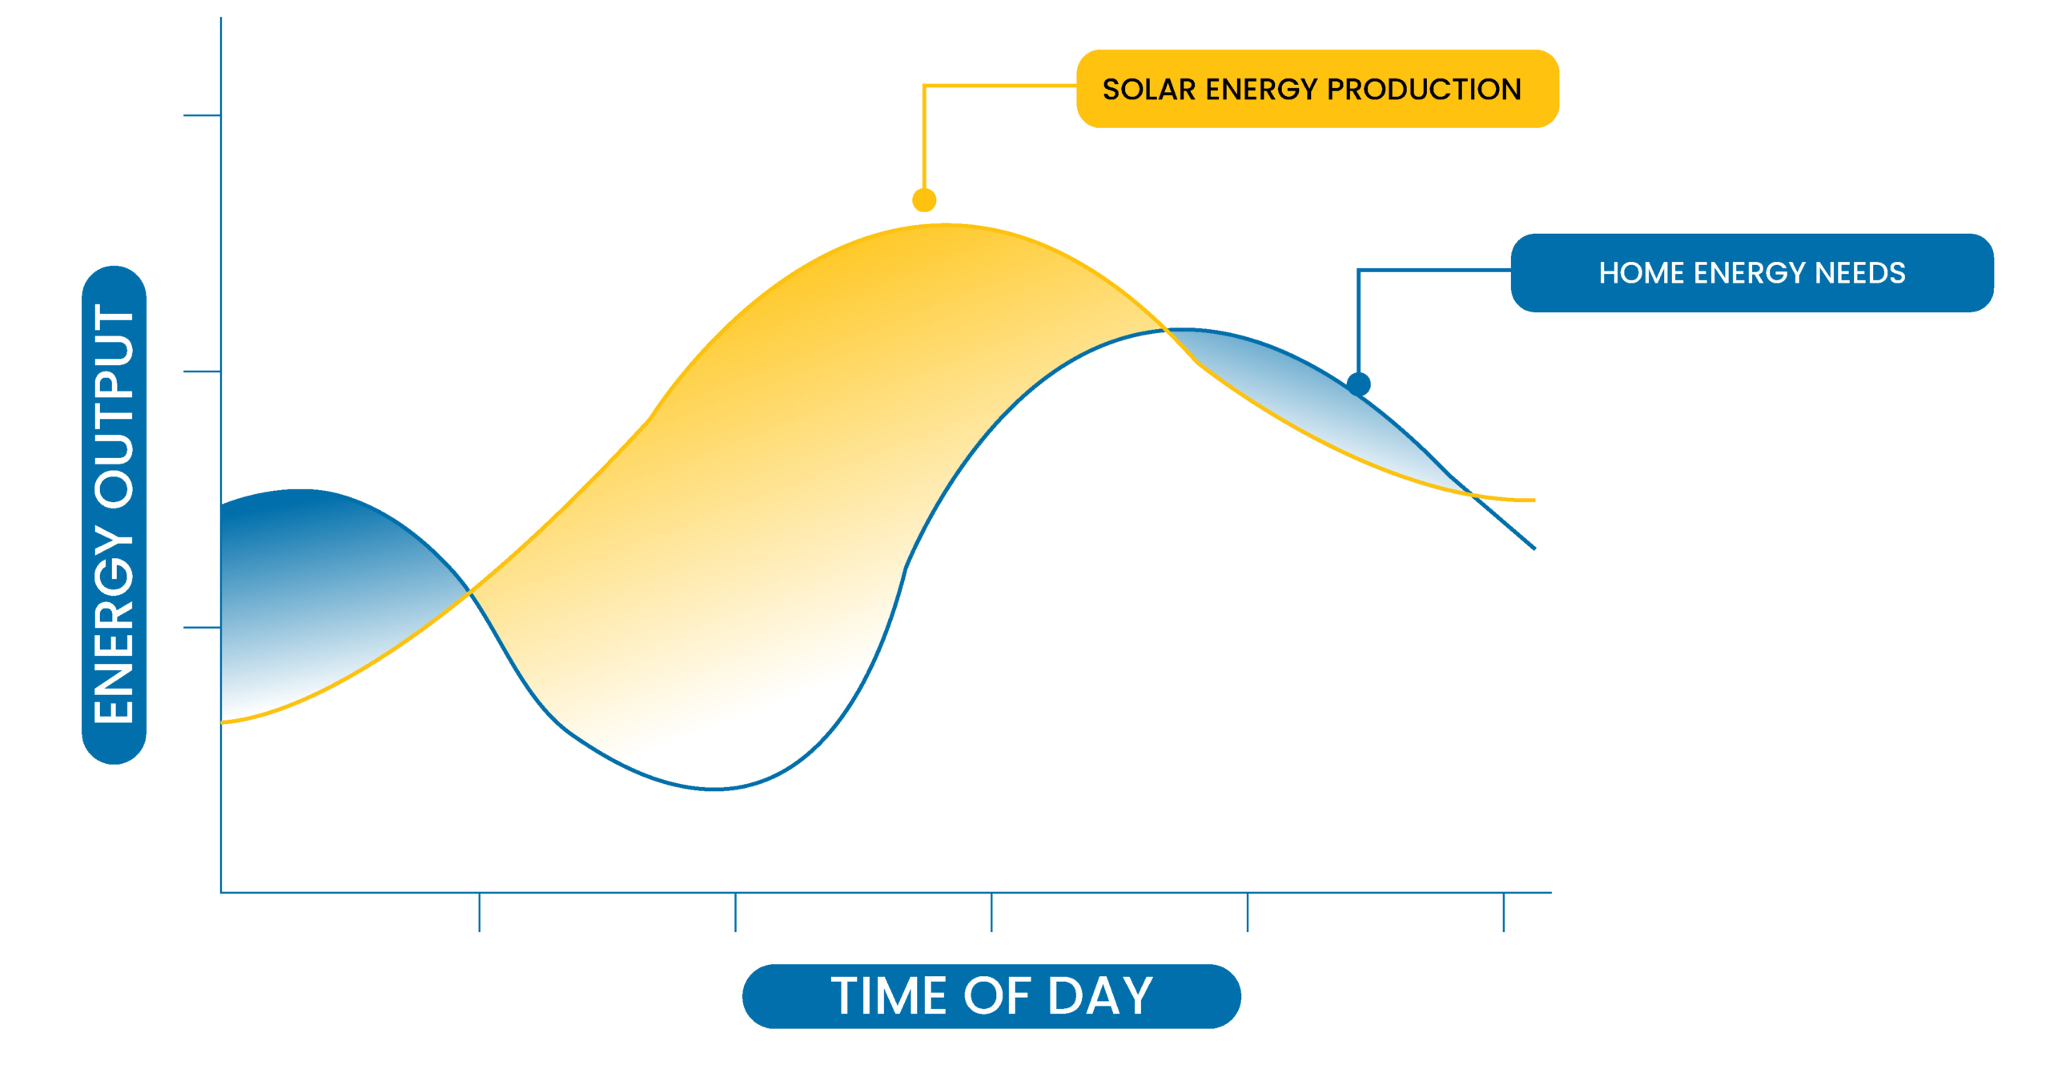
Net Metering

Slide 8
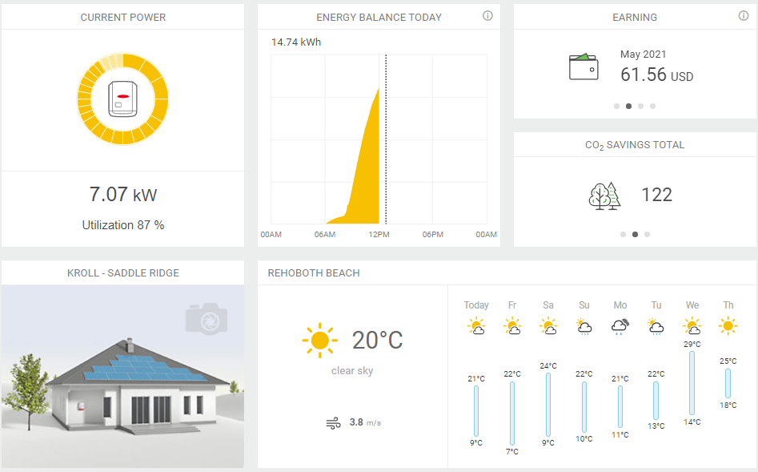
System Monitoring

Slide 9
Solar Renewable Energy Credits

Slide 10
SREC Value
Total Value over system lifespan
$400 per SREC
Year 1-10 | Year 11-20
SREC Value between $15-$25 | SREC Value $20
1 SREC per 1,000kWh | 1 SREC per 1,000kWh

Slide 11
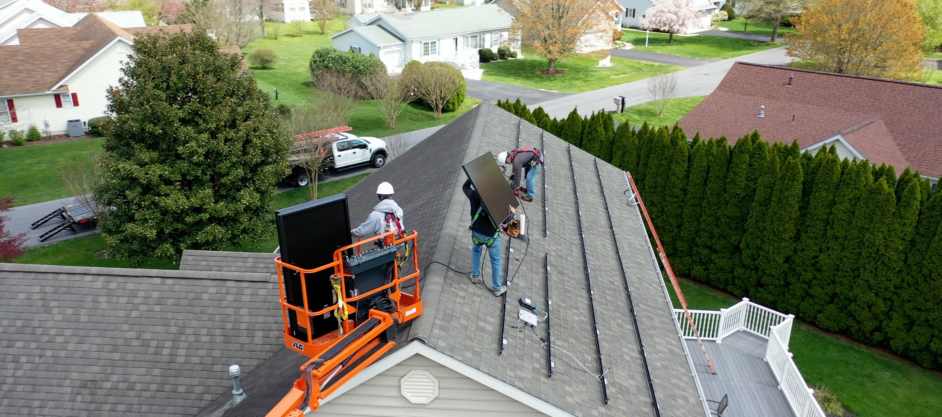
Installation

Slide 12
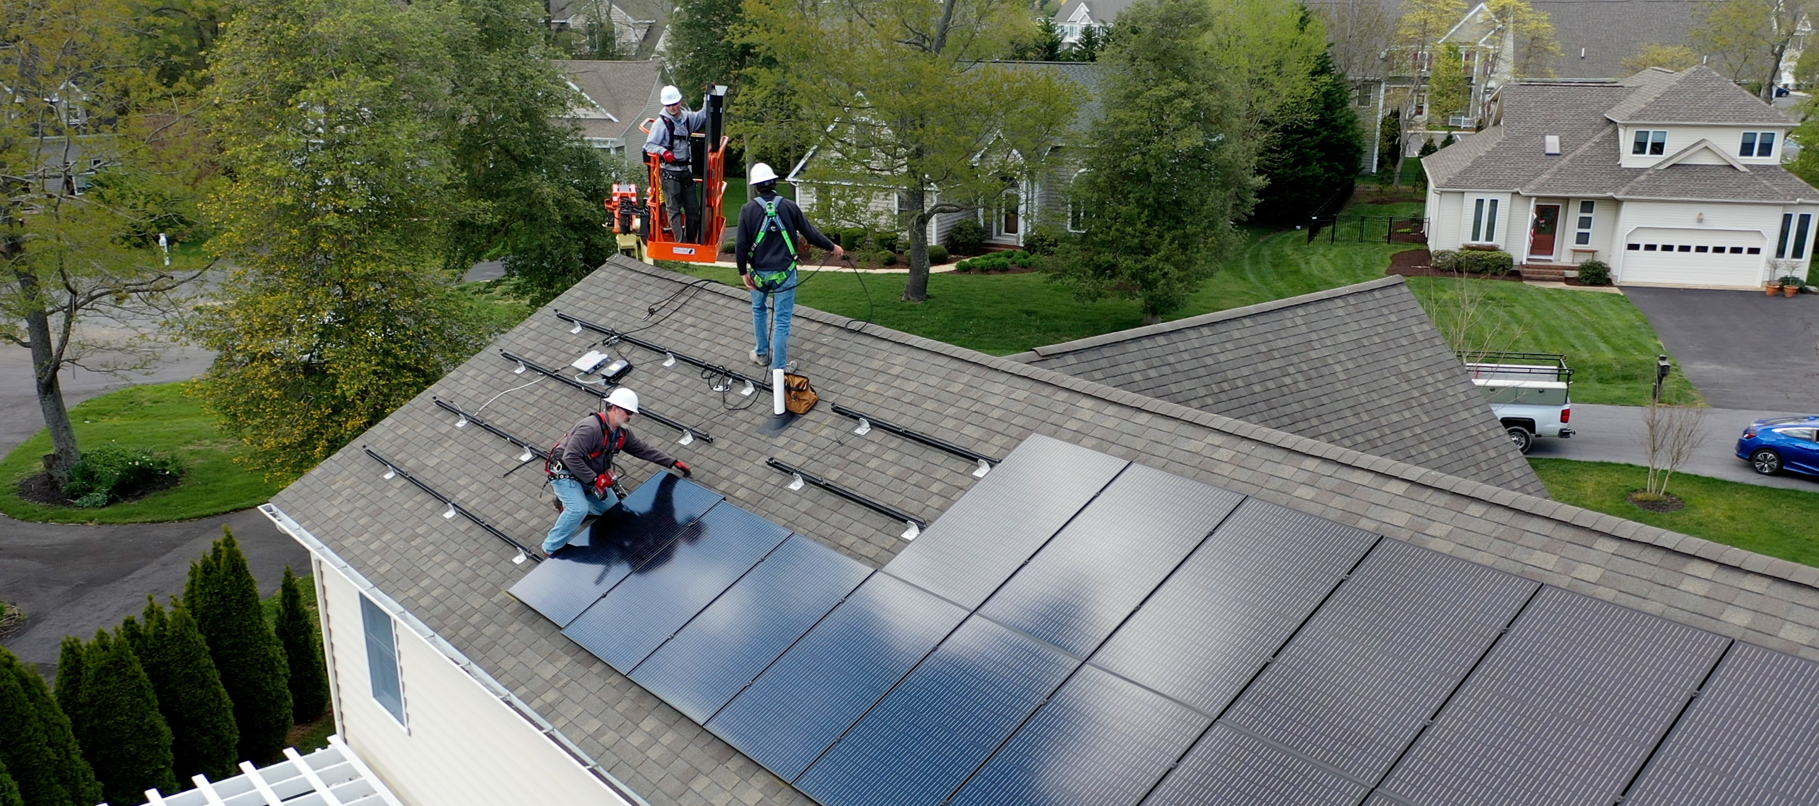
Installation

Slide 13
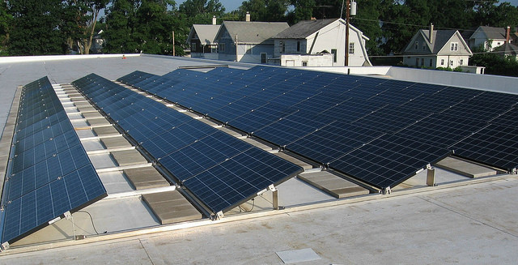
Installation: Flat Roof

Slide 14
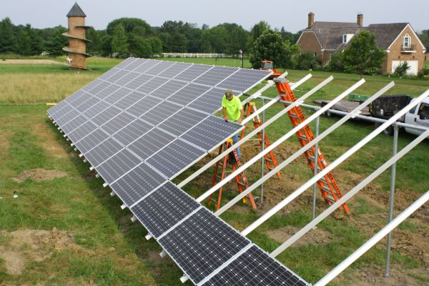
Installation: Ground Mount

Slide 15
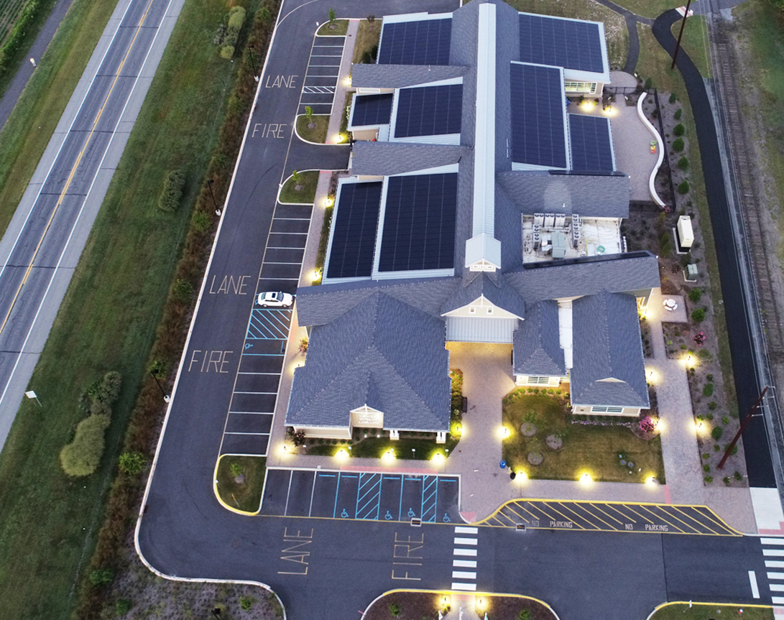
Installation

Slide 16
Solar Feasibility Process
Get an Electric Bill
Look at the Library on Google Earth
Design a system
Engineering Checks your structure
Permitting

Slide 17
Questions

